Slide 1
Implantation of heavy ions
⁸⁶Kr and ¹³²Xe
in emulsion with energy 1.2 A MeV
K.Z. MAMATKULOV
LHEP, JINR, Dubna, Russia.
DjPI, Uzbekistan.
“Workshop on Nuclear Track Emulsion and its Future”,
Predeal, Romania, October 14 - 19, 2013
Notes:
Layers of nuclear emulsions were irradiated with ions krypton and xenon, accelerated to an energy about 1.2 A MeV in a session in March 2013, at the accelerator complex IC-100 in Flerov Laboratory of Nuclear Reactions JINR, Dubna.

Slide 2
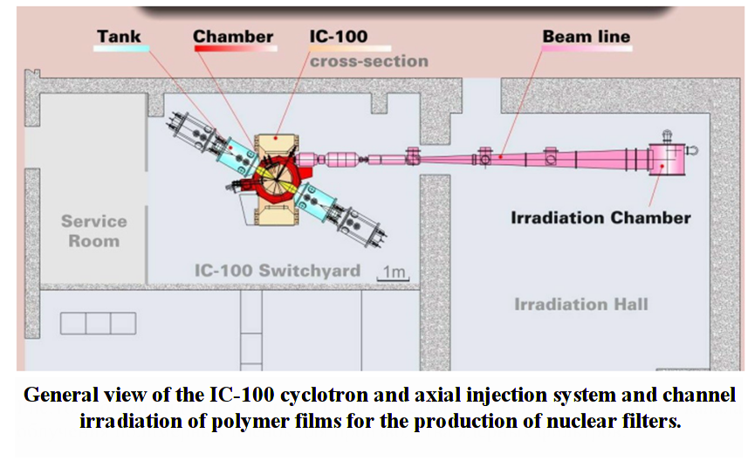
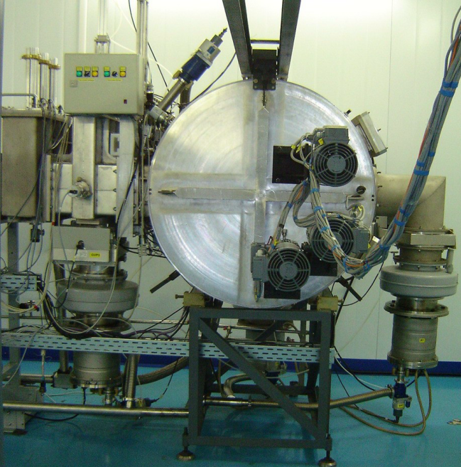
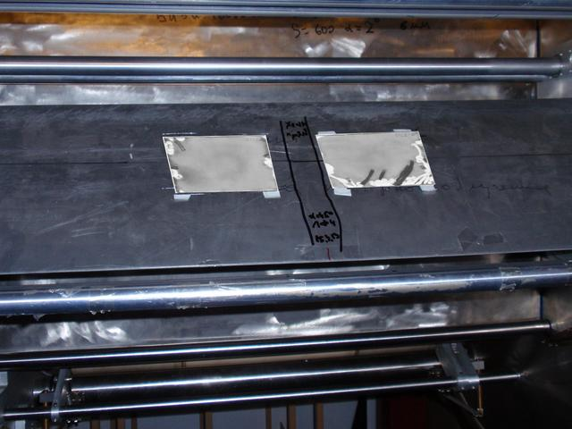
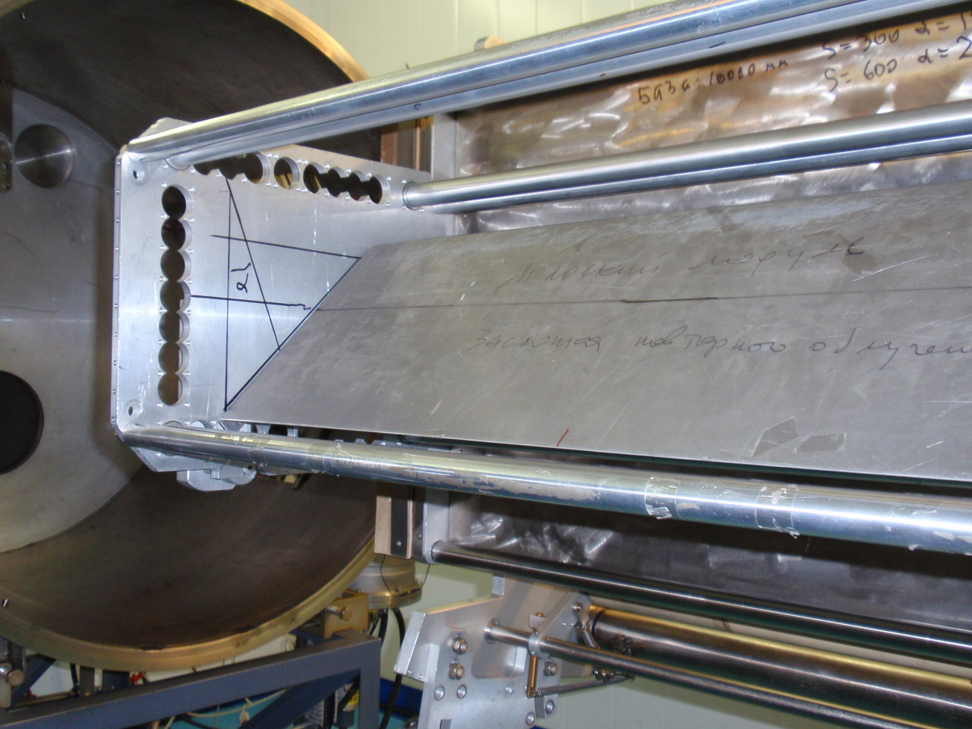
http://flerovlab.jinr.ru/flnr/ic-100.html
Pull-out part of the vacuum chamber with the board for mounting samples. Board put up at an angle of 45 ° to the beam of ions
Setting for irradiating the polymer film.
Placing detectors
Emulsion layers with size 9 × 12 cm² and with thickness ~ 100 (Xe) and ~ 180 (Kr) μm on a glass substrate with thickness ~ 2 mm, placed at an angle 45⁰ to the beam axis. Tilting plate has provided observability tracks of ions in the emulsion.
Notes:
In this slide presented the scheme producing a beam of ions in a cyclotron IC-100 and the place of nuclear emulsion layers.
Since the energy of these nuclei is small, it was necessary to irradiate the emulsion without using the light-protection paper, through which these ions could not be get into the emulsion. Therefore, fixing the emulsion plates in the chamber of the accelerator irradiation has required spend in ordinary lighting photo laboratories. We closed all slits in these room with black paper and worked under red light.
Desired track density was about 10⁵ - 10⁶ ions/cm², was needed 5 second irradiating, which corresponds to the parameters of the accelerator.
Setting for irradiating the polymer film.
Pull-out part of the vacuum chamber with the board for mounting samples.
Emulsion layers with size 9 × 12 cm² and with thickness ~ 100 (Xe) and ~ 180 (Kr) μm on a glass substrate with thickness ~ 2 mm, placed at an angle 45⁰ to the beam axis. Tilting plate has provided observability tracks of ions in the emulsion.

Slide 3
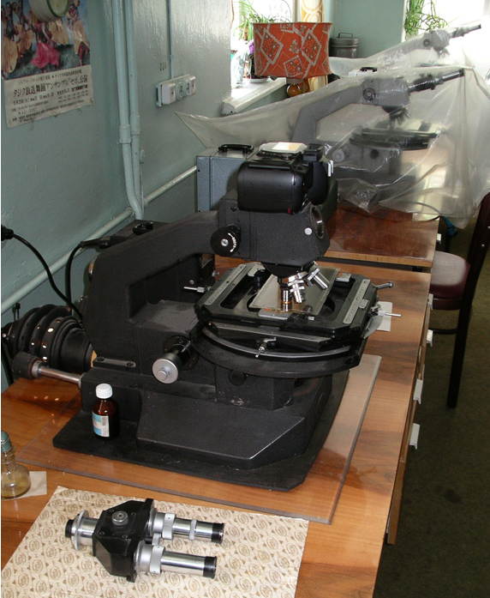
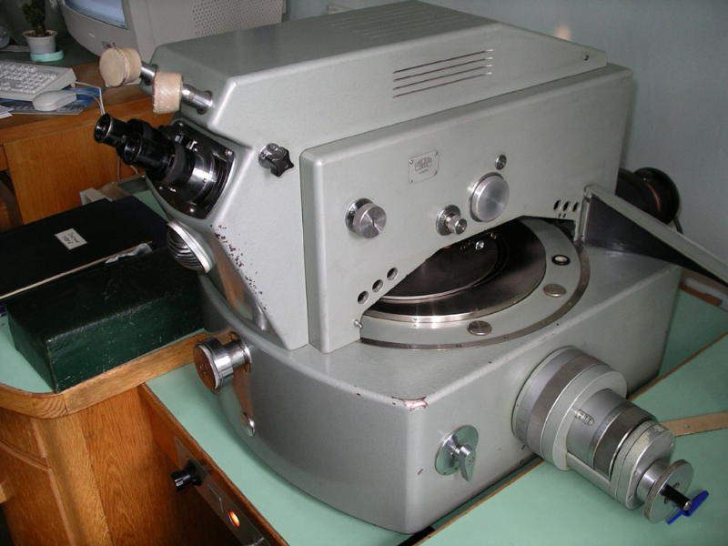
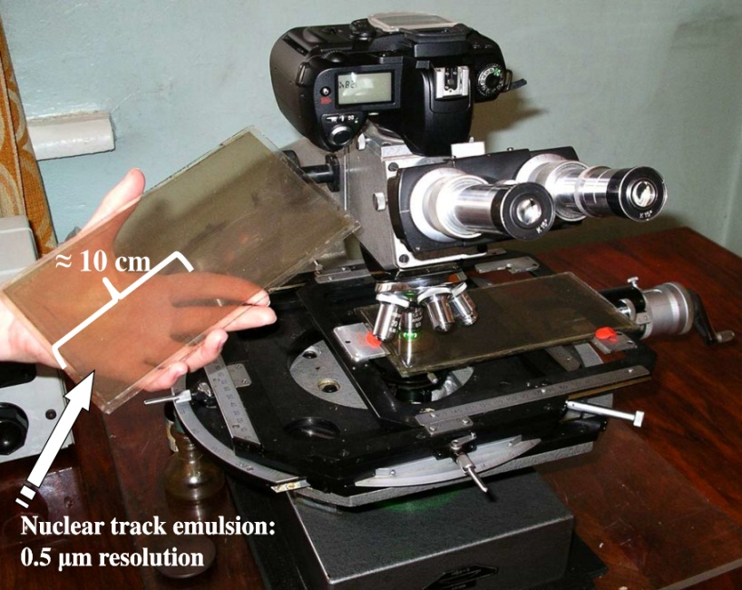

Slide 4
Kr Xe
View of emulsion layers after photochemical processing.
Notes:
Practice of irradiation showed that the samples necessary advance to test the strength under vacuum to avoid the risk of cracking and falling the pieces of emulsion with glass in the nodes of the accelerator.

Slide 5
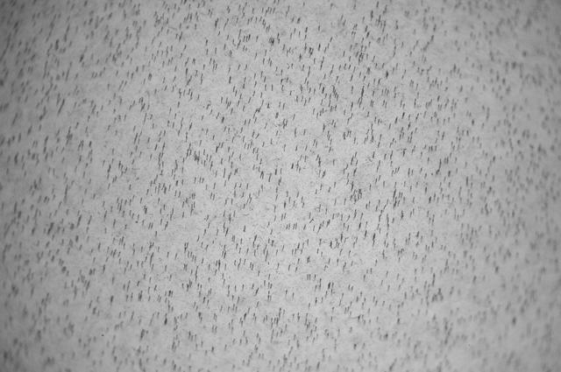
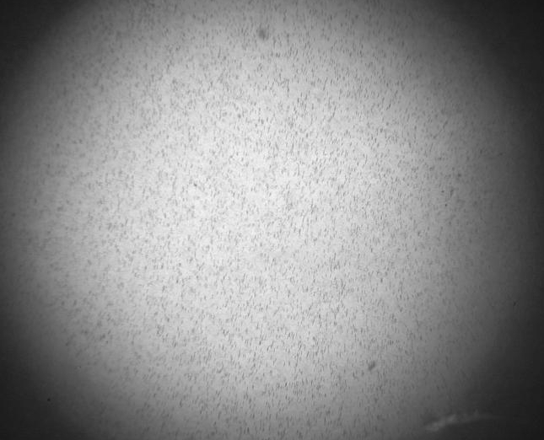
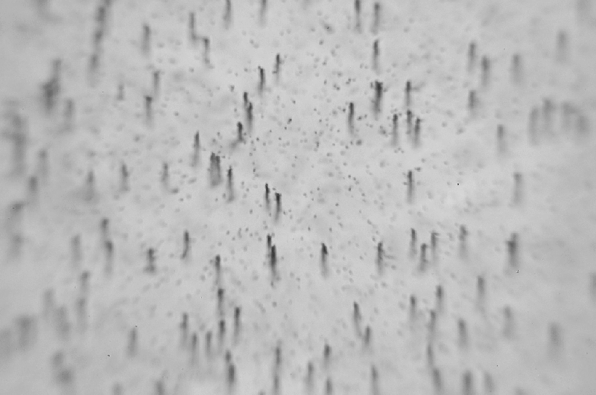
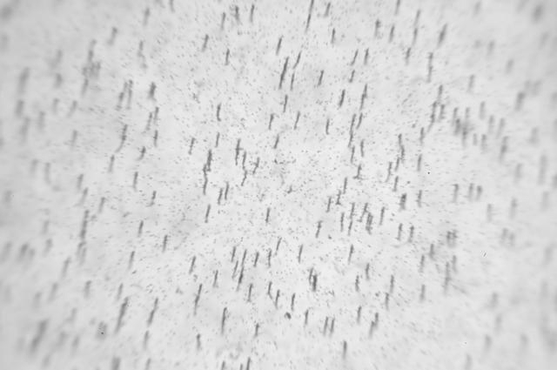
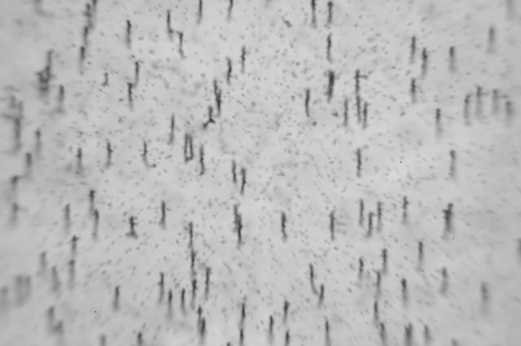
Examples of microphotograph of tracks (Kr) in emulsion.
x10 х20
x60 х90
Notes:
In this slide is presented example of microphotographs of krypton tracks at 90 times magnification.

Slide 6
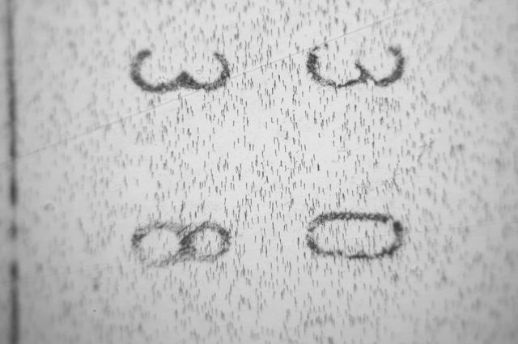
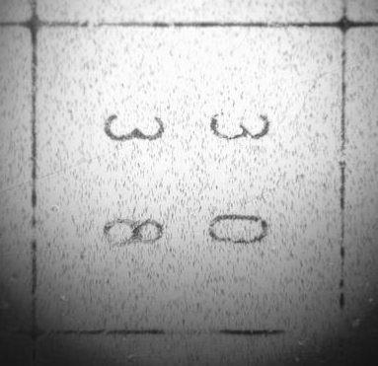
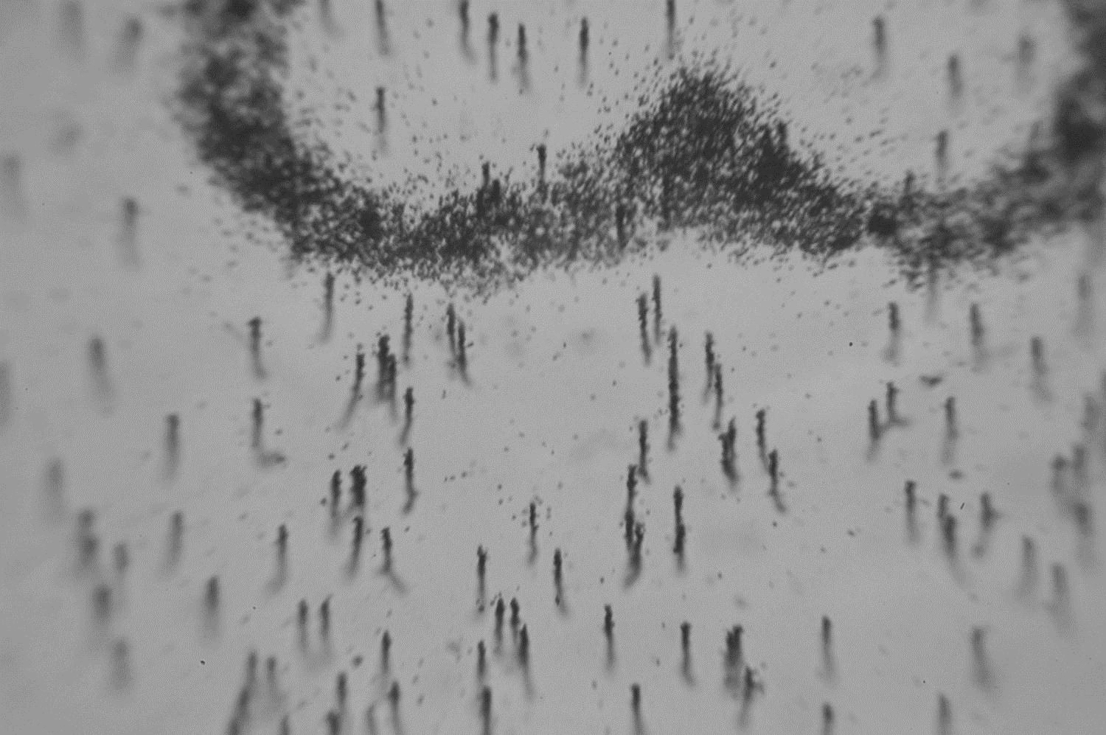
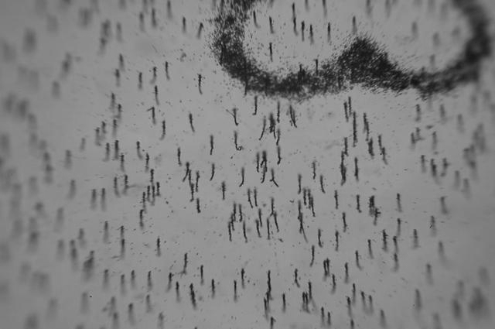
Examples of microphotograph of tracks (Xe) in emulsion.
x10 х20
x60 х90
Notes:
And in these Xenon example. Many of the tracks were completed as a curvature of result of the Coulomb scattering nuclei.

Slide 7
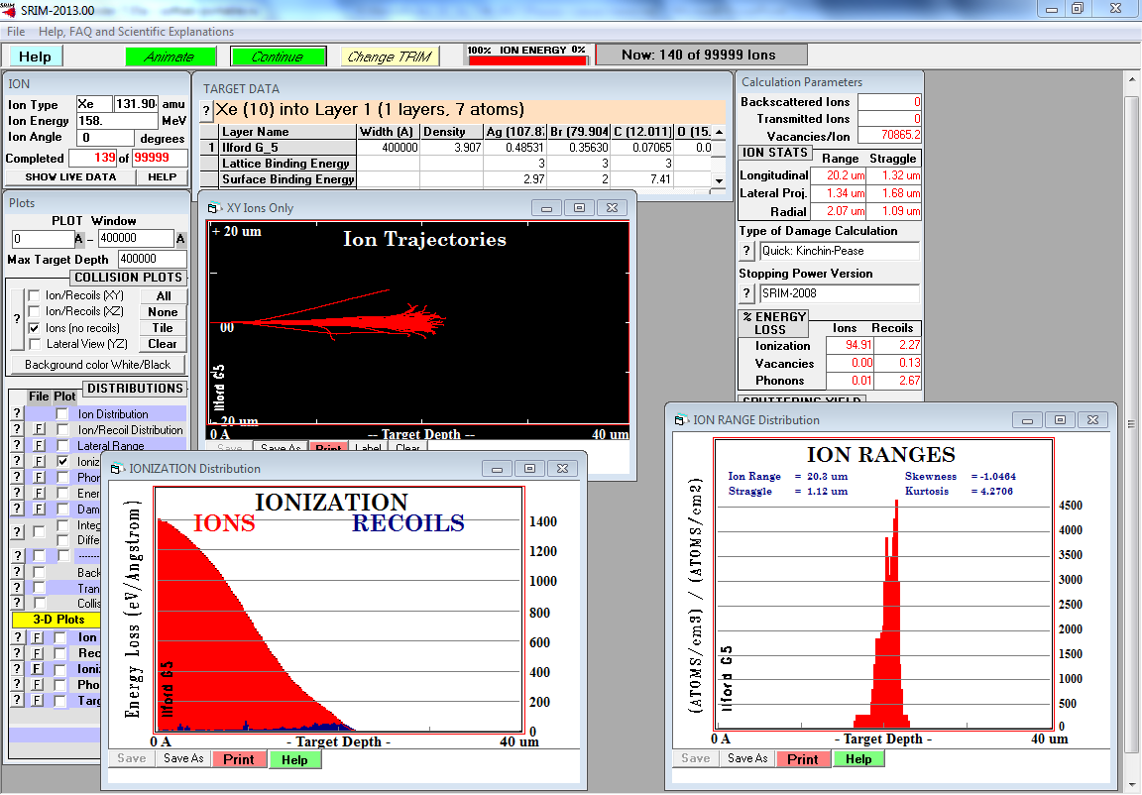
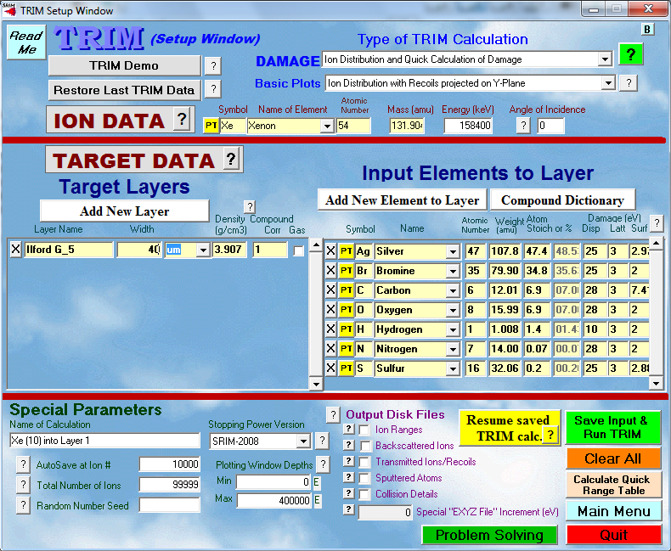
http://srim.org
Notes:
In these slide you can see screenshot of simulation program SRIM. You have to choose isotope of nuclei, add energy, choose target of layer, add thickness of target and run.

Slide 8
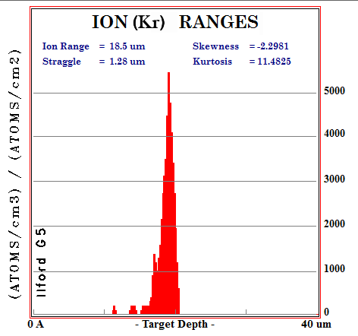
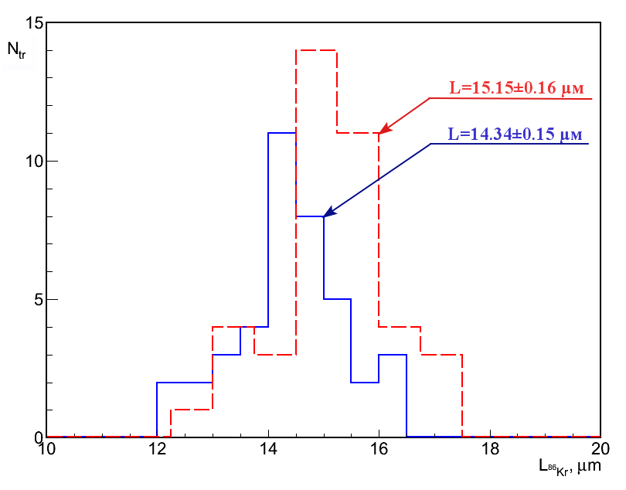
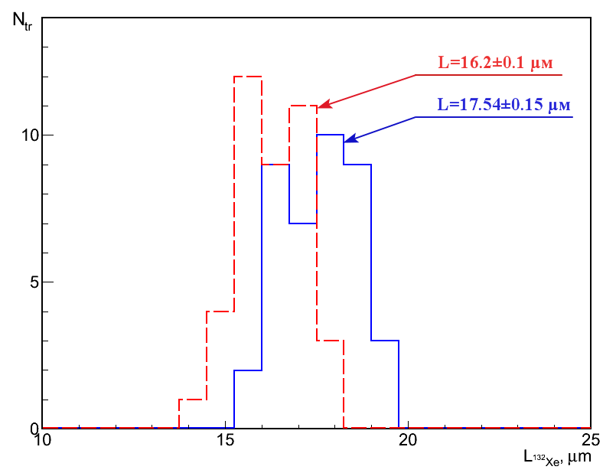
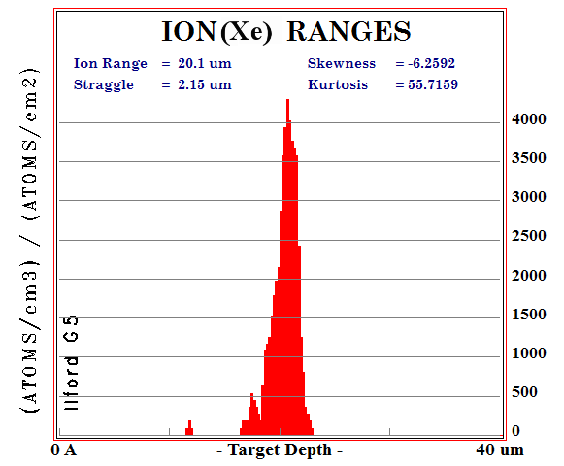
Notes:
In this slide for comparison, presented distribution of average length of Kr and Xe ions before and after correction of shrinkage ratio. The average length of 40 measured beam tracks without scattering and after correction of shrinkage ratio for krypton was equal to <L(86Kr)> = 14.34 μm and for Xenon <L (132He)> = 17.54 μm. These data are close to the calculated values by the model SRIM.
The difference of ion ranges can be attributed to with additional braking of ions on the residual air in installation.

Slide 9
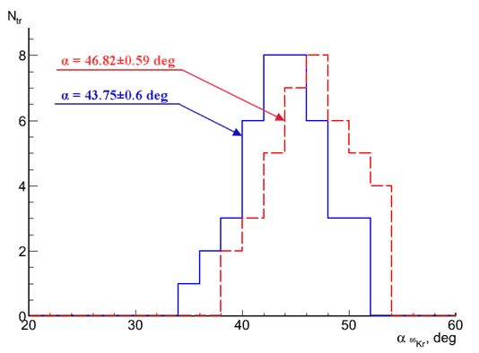
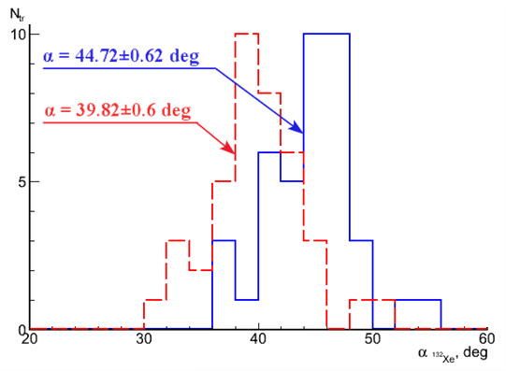
Irradiation angle before (red) and after (blue) correction shrinkage ratio.
Notes:
In this slide shows the angular distribution of dipping ions Kr and Xe into the emulsion before and after correction of shrinkage ratio.
Average angles before correction of shrinkage ratio amounted to Kr (46.80) and Xe (39.80), and after correction respectively - (43.80) and (44.70), which corresponds to orientation angle.
Средние углы до подправки на коэффициент усадки составили для Kr (46.8⁰ ±) и Хе (39.8⁰ ± 0,6), а после подправки соответственно – (43.8⁰ ± ), при RMS – 3.8⁰ (рис. 4.а.) и (44.7⁰ ± ), при RMS – 3.9⁰ (рис.4.b.), что соответствует углу ориентации.

Slide 10
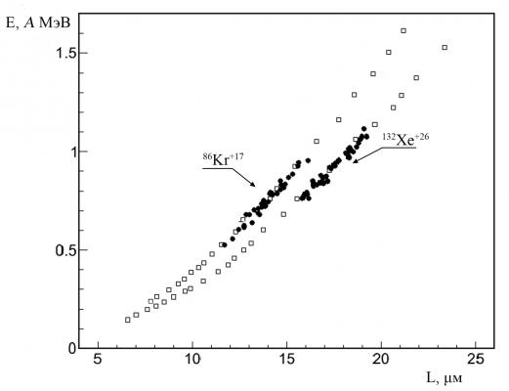
Definition energy of ions ⁸⁶Kr and ¹³²Xe by the measured track length.
Dots - experimental data, squares - calculation by the model SRIM.
Notes:
In this slide presents an energy distribution of ions 86Kr and 132Xe, which is obtained on the basis of spline-interpolation calculation range-energy by model SRIM. Their average values ​​after correction on the shrinkage ratio amounted for krypton <E(Kr)> = (0.74) A MeV and for Xenon - (0.92) A MeV.
Их средние значения после подправки на коэффициент усадки составило для криптона <E(⁸⁶Kr⁺¹⁷)> = (0.74 ± 0.01) A МэВ при RMS 0.09 A МэВ и для ксенона – (0.92 ± 0.01) A МэВ при RMS 0.1 A МэВ.

Slide 11
Conclusion:
Demonstrated the possibilities of the newly reproduced nuclear emulsion for research with heavy ions at extremely low energies (⁸⁶Kr and ¹³²Xe).
Defined angular spread of ions in the beam, which amounted 3.8 and 3.9 for Kr and Xe, respectively.
Measured ion range at the energy 1.2 A MeV in the emulsion amounted (L_{Kr} = 14.34 ± 0.15 μm, RMS = 0.9 μ m) and L_{Xe} = 17.54 ± 0.15 μ m, RMS = 0.99 μ m), which corresponds to the calculated value obtained by the model SRIM.
The results of this experiment are interest as a calibration for future research on the physics of nuclear fission, laser plasma, search for particles of dark matter, as well as applied purposes.

Slide 12
The present work is result of collaboration with specialists of accelerator IC-100, LNR, JINR.
THANK YOU ATTENTION!

